Slide 1

Introduction to Kidney Health and CKD Prediction Software
Presented by:
Mubashir Farabi (BSIT-2023-001)
Ahmed khan (BSIT-2023-140)

Slide 2
Why This Software?
“Addressing Critical Needs in CKD Diagnosis”
Chronic Kidney Disease (CKD) affects millions globally, yet early detection remains a challenge.
This software bridges the gap between manual evaluations and advanced predictive models, offering fast, data-driven support for doctors.

Slide 3
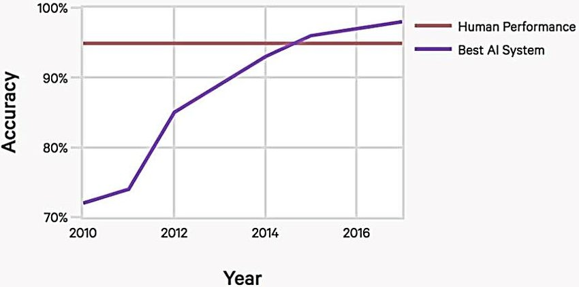
Will AI rescue the human errors

Slide 4
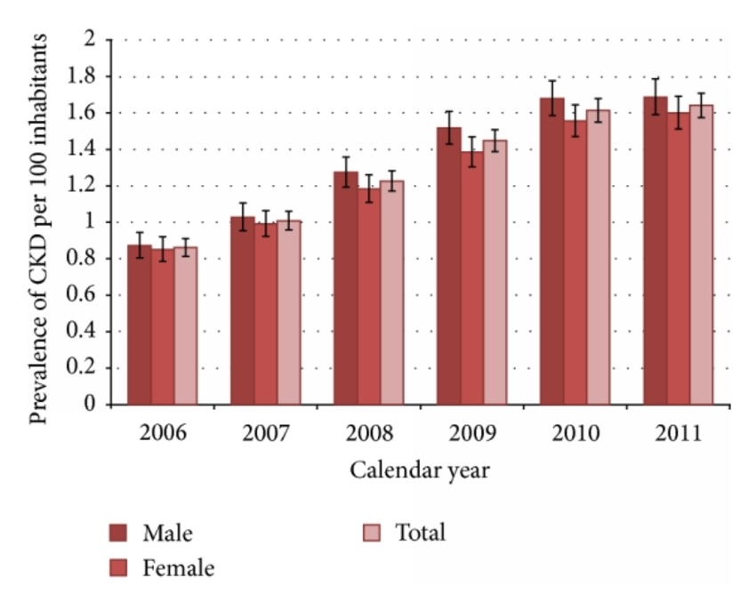
DATA OF CKD PATIENTS

Slide 5
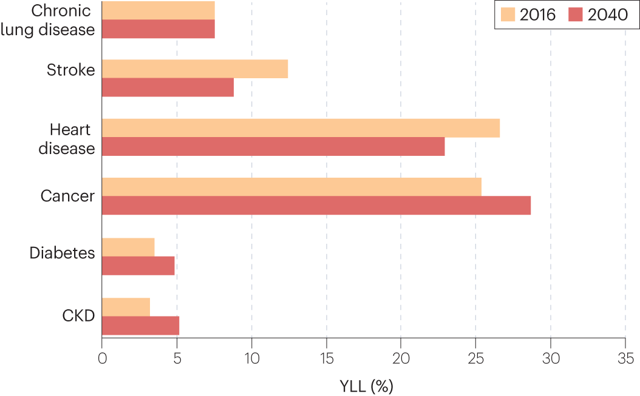
COMPARISION WITH OTHER DISEASE

Slide 6
. Significance: WHY IT MATTERS
“Accelerates the early detection of CKD, reducing complications.”
“Custom-built for healthcare environments, ensuring secure and ethical use.”
“Provides a standardized framework to evaluate patient data efficiently.”

Slide 7

Why Should Doctors Use It?
“Reliable predictions backed by robust datasets and machine learning algorithms.”
“Reduces the risk of human error in diagnosis.”
“Implementing technology in medical field ”
“Streamlined integration into hospital systems and lab workflows

Slide 8

Targeting Companies Who Can Buy This Software?
“ Targeting Hospitals looking to integrate cutting-edge diagnostic tools.”
“Diagnostic labs aiming to improve service accuracy.”
“Specialist urologists seeking data-driven patient management.”

Slide 9

How It Differs from Other Software?
"Our Competitive Edge”
“Focused specifically on CKD, unlike general health prediction tools.”
“Ethical by design: restricted access to certified professionals to prevent misuse.”
“Includes comprehensive visualizations and explanations for transparency in predictions.”

Slide 10

Key Advantages
Simple user inputs which can easily identify by patients
Simple and beautiful User Interface
“Reduces time for CKD diagnosis, enhancing patient outcomes.”
“Cost-effective solution for specialized healthcare providers.”
“Provides detailed feedback and recommendations based on the latest medical research.”
Model trained by verified and huge data set with accuracy of 75 too 80 percent

Slide 11
Conclusion: Making an Impact
"Revolutionizing Kidney Health Management“
“Our mission is to harness the power of technology to make healthcare smarter, safer, and more efficient, particularly in the early detection and management of chronic kidney disease.”
“Our vision is to implement simplicity and precision in the field of health using cutting-edge Machine Learning and Artificial Intelligence, ensuring that medical professionals have the tools they need to provide better care.”
“This software isn’t just a tool; it’s a step toward a future where technology and healthcare work seamlessly together for better patient outcomes.”
“Join us in making CKD detection and treatment more accessible to those who need it most, while empowering specialists with data-driven insights.”

Slide 12


